Slide 1

BE AN Entrepreneur
Be An Entrepreneur 2022-2023

Slide 2



Chapter 7
THE OPERATING PLAN
Be An Entrepreneur 2022-2023

Slide 3

Components of the Operating Plan:
Support Activities
Estimating Costs
1
2
3
4
5
Production activities
Capacity Planning
Business Location
Be An Entrepreneur 2022-2023

Slide 4
Chapter 7 overview
………..
1
2
3
4
The product or service that you offer to the public through your marketing plan is just the tip of the iceberg.
Unseen to the customer is a host of activities that create the product or make the service available.
The term “operations” covers these behind-the-scene activities.
You may say that marketing is the face your business presents to the outside world. Its inner workings fall under operations.
Be An Entrepreneur 2022-2023

Slide 5

Learning Objectives
State
State the subject and goal of an operating plan
Define and distinguish
Define and distinguish production activities from support activities
Illustrate a simple production process as a process flow or a flowchart.
State the goal of capacity planning and the sources of inefficiency
State
Distinguish
Distinguish start-up costs from running costs.
Be An Entrepreneur 2022-2023

Slide 6
Story from Real Life
Mystic Masala is a small business in Canada. It offers handmade aromatherapy soy candles and body and shampoo bars made with spice, herb, and flower oils.
Importing is vital to its operations.
Based on her experience, the owner has several suggestions when importing.
Do your homework before you begin. Know the product codes and laws that apply to the goods you want to import.
Be An Entrepreneur 2022-2023

Slide 7
Story from Real Life
Customs brokerage fees vary depending on the agent.
Shop around for a cost-effective and reliable option.
If you’re good with paperwork, doing them yourself could save several hundred dollars a shipment.
It can be more difficult to guarantee quality when shipping merchandise.
“Originally, I had my soaps shipped via boat but after coming all the way from Nepal in the heat and through the monsoon season, they didn’t always arrive in the best shape.
“Now I have them sent by air cargo.”
Be An Entrepreneur 2022-2023

Slide 8

The operating plan
ROADMAP
CONSISTS
The operating plan consists of the following sections:
Your operating plan lays down the roadmap that will show how you will convert inputs into products in a cost-effective manner.
Production activities
Support activities
Capacity planning – start-up costs
Estimating Costs – now includes running costs
Be An Entrepreneur 2022-2023

Slide 9



The operating plan
Operations:
1
2
3
The set of activities that convert inputs into outputs.
The marketing plan should determine the operations plan.
By having marketing as the driver of the enterprise, you ensure that your product and the activities that create it are aligned with the needs of the customer.
Inputs are the resources used by your business such as materials, labor, and machines.
Outputs are the goods you produce or the services you provide.
Be An Entrepreneur 2022-2023

Slide 10
The operating plan
Production activities
1
Production activities are the business activities that are directly related to making goods or providing services.
Process flow is a visual representation of the steps and sequence required to make a product. The steps are normally limited to production activities.
2
Be An Entrepreneur 2022-2023

Slide 11
The operating plan
Flowchart:
The activities and sequence of a process represented in symbols. Each step in the process is shown as a symbol with a short description of the step. The symbols are linked together with arrows to show the proper sequence of the activities.
Be An Entrepreneur 2022-2023

Slide 12
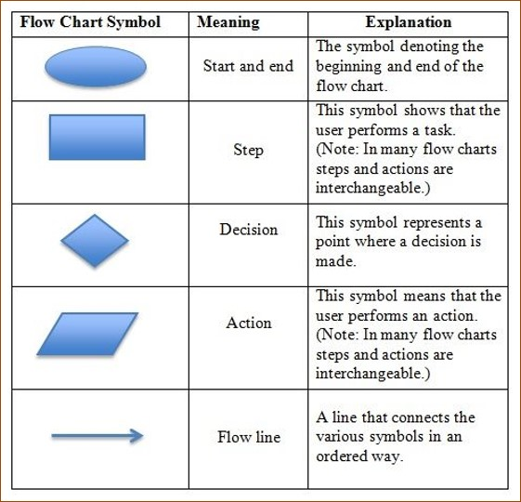
Flow chart symbols
A flowchart represents in symbols, the activities of a process and their sequence.
Be An Entrepreneur 2022-2023

Slide 13
The operating plan
Support activities:
Activities
Support activities
Activities that help production activities to function as intended though they do not produce the goods themselves.
Support activities: are there to aid production. They add value to the production process.
Be An Entrepreneur 2022-2023

Slide 14
The operating plan
Capacity planning:
PROCESS
CAPACITY PLANNING
The process of deciding the production capacity to meet the demand for the products of a business.
Capacity planning: means to schedule over time, the investments and resources you business will need to produce at a desired level.
Be An Entrepreneur 2022-2023

Slide 15
The operating plan
Cost estimates
Start-up costs:
Costs associated with putting up the production capacity of a business. These costs enable your business to begin operations though you have not done so yet.
Be An Entrepreneur 2022-2023

Slide 16
The operating plan
Cost estimates
START-UP COSTS
RUN OPERATIONS
Start-up costs are costs associated with setting up the production capacity of a business.
To run operations, your business will require inputs like raw materials, supplies, rent, labor and electricity. These are the running costs.
Be An Entrepreneur 2022-2023

Slide 17
The operating plan
Differences between
UNIT COST
RUNNING COSTS
Recurring costs associated with inputs to continuing operations.
The total cost to produce one unit of a product or service.
Be An Entrepreneur 2022-2023

Slide 18
Business Location
Choosing a business location is one of the most important aspects of starting a small business. It can dictate foot traffic, business atmosphere and long-term success for your small business. Finding the right location means understanding the right qualities to look for in a potential space. Analyzing your area, reading about potential customer demographics, and considering where competitors are located are all important aspects to finding and choosing the right location.
Be An Entrepreneur 2022-2023

Slide 19
Business Location
Compliance with law.
5
Foot Traffic
Cost of the location
3
4
Competition
1
2
Be An Entrepreneur 2022-2023
Acceability

Slide 20











Cost of the location
Compliance with law.
Business
Competition
Location
Acceability
Foot Traffic
Be An Entrepreneur 2022-2023

Slide 21
Business Location
1
Cost of the location
Budget is the most important reason for location while choosing a suitable business location. Think of how much can you afford to spend on your business location and find ways for it. You might have many business location ideas, but it should be affordable. While city centers and mean streets might be great for talent and accessibility, they are usually very expensive. Real estate, utilities and rates in big cities can be expensive if you’re looking to lease a building.
Be An Entrepreneur 2022-2023

Slide 22
Business Location
2
Accessibility
It sounds simple but, whether it’s accessing new markets, customers or resources, transportation is crucial for not just your people but everyone you work with to get around effectively. Finding a location that can be easily accessed by both your customers and your staff can make or break a business. For example, you might find the perfect bricks and mortar store in the city center for a reasonable price, but there is no parking nearby.
Be An Entrepreneur 2022-2023

Slide 23
Business Location
3
Foot Traffic
More than many businesses look for foot traffic and this is one of the top factors to consider when choosing business location. No business wants to be swayed away in a corner where potential customers will pass them. On the contrary, if some business needs confidentiality, they should opt for a low-traffic area. Try to monitor the traffic outside a certain location at different times of the week.
Be An Entrepreneur 2022-2023

Slide 24
Business Location
4
Competition
The business location factor creates both an advantage and a disadvantage. Consider if a location has a huge number of consumers because of the business competitors, your business might attract them as well. Therefore, competing is an important factor while selecting a city or town as a business location. However, it might backfire if both sides sell the same product, one team will end up losing.
Be An Entrepreneur 2022-2023

Slide 25
Business Location
5
Compliance with law
Local zoning regulations might limit small business locations. Zoning rules might restrict what plot or buildings can be used for commercial purposes, hours of operation, noise levels, signage types, and chemical usage. The need for selecting a suitable location can be competitive and hard, which is why it must be made sure the building’s zoning designation matches the business’s requirements.
Be An Entrepreneur 2022-2023

Slide 26

Do your operation plan
Operation plan
https://knowhow.ncvo.org.uk/tools-resources/business-plan-template/writing-your-business-plan/8-operational-plan
Be An Entrepreneur 2022-2023

Slide 27
Review Questions
1
What is the goal of an operating plan?
3
Should marketing determine operations or the other way around? Why?
2
What are the sections of an operating plan?
4
What happens when support activities are neglected?
Be An Entrepreneur 2022-2023

Slide 28
Review Questions
5
What is the output of capacity planning?
7
Why can demand still be different from capacity despite careful planning?
6
What happens when there is too much (or too little) capacity compared to demand?
8
How are start-up costs different from running costs?
Be An Entrepreneur 2022-2023

Slide 29

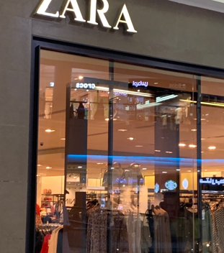
Case Study questions
Would you say that ZARA is very successful? What facts in the case tell you this?
Many other successful fashion retailers outsource production to countries where labor cost is low rather than producing the items themselves.
ZARA produces 50% of its sales with its own facilities.
Why did ZARA do this? What are the pros and cons of this strategy?
Be An Entrepreneur 2022-2023

Slide 30
Case Study questions
Many other successful fashion retailers outsource production to countries where labor cost is low rather than producing the items themselves.
ZARA produces 50% of its sales with its own facilities.
Why did ZARA do this? What are the pros and cons of this strategy?
What is your own view of using operations as the main means to compete in an industry like fashion retailing?
Be An Entrepreneur 2022-2023

