Slide 1

BE AN Entrepreneur
Be An Entrepreneur 2022-2023

Slide 2














Be an Entrepreneur
The Entrepreneur
Part 1:
Chapters : 1,2,3,4
The Business Plan Chapters : 5,6,7,8
Part 2:
The Enterprise
Chapters : 9,10,1,11,12,13
Part 3:

Slide 3



Chapter 5
THE BUSINESS PLAN
Be An Entrepreneur 2022-2023

Slide 4
THE BUSINESS PLAN
What is a Business Plan?
1
2
Contents of the Plan
Be An Entrepreneur 2022-2023

Slide 5


Chapter 5 overview
Explain why entrepreneurs need one,
How to go about writing the plan.
1
2
3
4
5
executive summary, company summary,
Define the business plan,
who will read it, and
We highlight the:
management profile, and risk-and-reward profile.
Be An Entrepreneur 2022-2023

Slide 6

Learning Objectives
Define
Define a “business plan"
List
List the readers of a business plan
List
List the characteristics of a good business plan
List
List the components of a business plan
Know
Know what readers look for in the executive summary
Be An Entrepreneur 2022-2023
Know
Know why he should write a business plan from the point of view of the investor.

Slide 7


Story from Real Life
The founder of Haraj website is the millionaire Youssef Al-Rashidi. He established Haraj website in 2008 at a cost not exceeding 220 US dollars, while the market value of Haraj site currently exceeds 200 million US dollars, according to the statements of the founder of the site.
He is an engineer who graduated from the College of Computer at King Fahd University of Petroleum and Minerals, in 2007. He had launched a forum on the Internet, called Haraj, and this forum was for shares, until people started offering their cars for sale to him. When he graduated and did not find a job, he returned to Haraj and thought of creating a special site for these advertisements.
Be An Entrepreneur 2022-2023

Slide 8
Story from Real Life
CORPORATE ORGANIZATION
VOLUME OF SALES
In 2013, the management of “Haraj” transformed from an individual person to a corporate organization with more than 30 qualified and competent employees. In 2016, the founder of Haraj website refused to sell a share ranging from 20 to 30% of his website, with a value of $20 million, because the offer did not fit the site’s popularity, in addition to the fact that the site was not established for a profit-only goal.
He said that the volume of sales traded monthly through the site has reached 400 million riyals, and 10,000 ads are added daily, indicating that he does not want to increase the site's commission (1%) because it is not for profit, but rather a symbolic amount to support the site and its operator in order to continue.
Be An Entrepreneur 2022-2023

Slide 9
What is a Business Plan?
Business plan:
1
A detailed statement of what your business is going to do in the future.
2
The business plan is your means of communicating your vision to the world to help you attract talent and money to the business.
4
The readers of your business plan are: banks, venture capitalists, and private investors. Also, your management team and business partners.
3
It is a detailed statement of what your business is going to do in the future.
Be An Entrepreneur 2022-2023

Slide 10
What is a Business Plan?
Business plan:
5
Write the plan from the point of view of the reader.
7
It will help you to respond to the reader's concerns, rather than letting yourself write what interests you, the entrepreneur.
6
It will help enormously to put yourself in the place of your prospective investor.
Be An Entrepreneur 2022-2023

Slide 11
What is a Business Plan?
The characteristics of a good business plan:
contains visuals and graphs.
easy to understand
short and simple
contains no typing errors
interesting
Be An Entrepreneur 2022-2023

Slide 12
What is a Business Plan?
Business model
Business plan
Differences between
The method used by the firm to create and achieve value.
It comes after the feasibility study, and before building a business plan.
The goal is to build a preliminary picture of the main project elements
A tool to aid in decision making
It includes the most important elements of the project and written on one page.
It is a visual drawn method
It is used for innovative projects such as smart phone applications
To answer the question: What should we provide or do?
It is a roadmap that contains a detailed study of all aspects of the project in order to be able to implement it.
It comes before the start of the project
The goal is to develop a detailed plan for how the project will be implemented.
A tool to aid in decision making
A document with many pages containing project creation details.
It is a narrative and explanatory method
It is used in traditional and innovative projects
To answer the question: How will we carry out or manage the project?
Be An Entrepreneur 2022-2023

Slide 13
What is a Business Plan?
Find a Mentor:
In today’s competitive world, an entrepreneur needs assistance to succeed. One way to get this type of assistance is by hiring a mentor. This will allow you to talk with individuals who are knowledgeable in the various aspects of business and learn from the success and mistakes of others – thus helping you to become more successful and avoid the same mistakes.
Be An Entrepreneur 2022-2023

Slide 14
Contents of the Plan
1
2
3
4
5
Cover letter, title page, and table of contents
Executive summary
Vision and Mission
Company summary
Market analysis
6
7
8
9
10
11
Marketing plan
Operations plan
Business model and financial forecasts
Management profile
Risk-and—reward profile
Appendix
Be An Entrepreneur 2022-2023

Slide 15



Contents of the Plan
Cover letter, title page, and table of contents:
1
2
3
Every business plan begins with a clean and clear cover page that tells the reader what to expect in the document to follow.
The title page should highlight the plan’s major focus. It should draw attention to the purpose of the plan and clearly spell out the project being presented.
The table of contents outlines the entire plan, specifically listing the sequence of the plan’s topics that will lead the reader to your desired conclusion.
Be An Entrepreneur 2022-2023

Slide 16


Contents of the Plan
Executive summary:
1
2
The first section of a business plan covering the main points of the document.
Its purpose is to convince readers that your business has merit. It encourages them to read the remaining sections.
Be An Entrepreneur 2022-2023

Slide 17
Contents of the Plan
The executive summary should explain:
Financial requirements: much is needed
Benefits: unique selling proposition
Opportunity: market potential of the business.
Growth: how your company will grow in the next few years.
Purpose: intent of your business plan.
2
Be An Entrepreneur 2022-2023

Slide 18
Contents of the Plan
Company summary:
1
2
The section of the business plan that tells the readers what the company is, who is behind it and where it is going.
It provides a brief account of business operations, history, purpose and organization.
Be An Entrepreneur 2022-2023

Slide 19


Contents of the Plan
VISION
MISSION
A vision statement sets an organization's sights on the future. It is an inspirational statement of an idealistic emotional future of a company.
A mission statement is a short statement of why an organization exists, what its overall goal is, identifying the goal of its operations: what kind of product or service it provides, its primary customers or market, and its geographical region of operation.
Be An Entrepreneur 2022-2023

Slide 20
Contents of the Plan
Vision and Mission
VISION
Where you want to be
MISSION
What you want to do
STRATEGY
How you’ll get there
ACTIVITIES
What you need to do now
Be An Entrepreneur 2022-2023

Slide 21


Contents of the Plan
Vision
What are the hope and dream for the company? (The ideal future)
What problem are we solving for the greater good?
Who and what are we aspiring to change?
Be An Entrepreneur 2022-2023

Slide 22
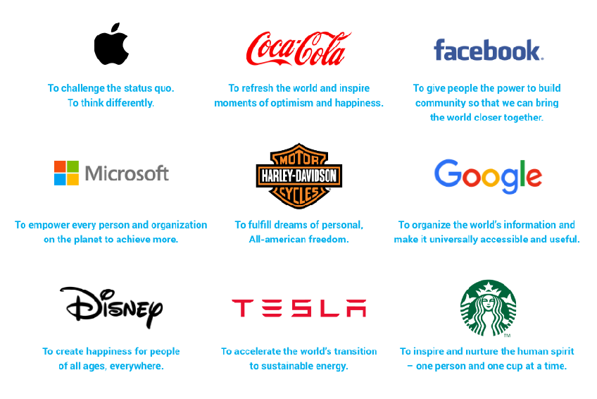

Contents of the Plan
Mission
What do you do?
Who do you serve?
How your brand is different in your own way?
Be An Entrepreneur 2022-2023

Slide 23

Contents of the Plan
Management profile:
The section of the business plan that details the backgrounds of the company’s management team.
Be An Entrepreneur 2022-2023

Slide 24
Contents of the Plan
We will allocate separate chapters for the remaining contents
6
7
8
9
10
11
Marketing plan
Operations plan
Business model and financial forecasts
Management profile
Risk-and—reward profile
Appendix
Be An Entrepreneur 2022-2023

Slide 25
Points to Remember
The major sections in the business plan are:
Risk-and-reward profile.
5
Company summary,
Executive summary,
3
4
Management profile,
1
2
Be An Entrepreneur 2022-2023
Mission and vision

Slide 26
Points to Remember
The company summary tells the readers what the company is, who is behind it, and where it is going.
3
The executive summary covers the highlights of your business plan.
4
The company summary should include names, background, history, and goals.
1
2
The purpose of the summary is to convince readers that your business has merit.
Be An Entrepreneur 2022-2023

Slide 27
Points to Remember
2
1
Businesses have opportunities as well as risks. A good business plan does not skip the risks. Risk is unavoidable. Your business plan must unflinchingly confront risk in terms of potential problems and threats
The management profile includes organizational chart of managers, resumes, and professionals.
Be An Entrepreneur 2022-2023

Slide 28

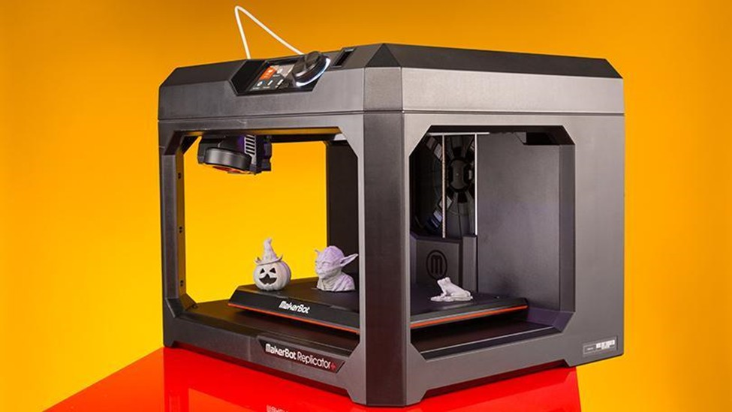
Case study:
3D Printing
Business Plan Template
Be An Entrepreneur 2022-2023

Slide 29

Business Plan Example
LOLO Fitness
LOLO Fitness is a proposed fitness center targeting women in Jeddah, Saudi Arabia. The concept is to create an environment dedicated to obtaining/maintaining physical and mental well-being. LOLO Fitness will be the first of its kind in the community offering exercise machines designed for women, personal trainers, a dietary consultant, massage therapists, and apparel shop, all with women-only in mind. The class schedule will also concentrate on both mind and body exercise with everything from step aerobics to yoga. In order to start this business, LOLO Fitness will need start-up funds to purchase necessary equipment and furniture, and a line-of-credit to extend early cash shortages
Be An Entrepreneur 2022-2023

Slide 30

Review Questions
Do your Business Plan
https://knowhow.ncvo.org.uk/tools-resources/business-plan-template/writing-your-business-plan
https://www.princes-trust.org.uk/help-for-young-people/tools-resources/business-tools/business-plans
Be An Entrepreneur 2022-2023

