Slide 1

BE AN Entrepreneur
Be An Entrepreneur 2022-2023

Slide 2



Chapter 4
DETERMINE THE BUSINESS OPPORTUNITY
Be An Entrepreneur 2022-2023

Slide 3

DETERMINE THE BUSINESS OPPORTUNITY
What the customer wants ?
Protect your idea
1
2
3
What the Entrepreneur Wants to Do ?
Be An Entrepreneur 2022-2023

Slide 4
Chapter 4 overview
Part 1 of the chapter will focus on the customer. Specifically, for you to develop a business opportunity, you need to think about the customer’s needs.
1
2
In part 2, you select a business opportunity based on its appeal to you, the entrepreneur.
(Even if the customers clamor for a particular product, that product will only be supplied if the entrepreneur takes action.)
Be An Entrepreneur 2022-2023

Slide 5

Learning Objectives
Be
Be able to select a business opportunity from the point of view of the customer
Learn
Learn how to spot an opportunity when a human need is not being met .
Search
Search for a business opportunity
Find
Find a unique selling proposition
Be
Be able to select a business opportunity from the point of view of the entrepreneur
Be An Entrepreneur 2022-2023
Protect
Protect the business idea with a patent.

Slide 6


Story from Real Life
In 1995, the Internet was fast becoming an indispensable part of the life of urbanized individuals. It was the dotcom era and American investors were as feverish as when gold was first discovered. But the Web was a messy, disorganized place. People bounced from website to website with no logic in their Internet travels.
Be An Entrepreneur 2022-2023

Slide 7

Story from Real Life
Distinctive algorithm
Nowadays
While search engines existed since 1945, few became widely used. In 1996, Sergey Brin and Larry Page, graduate students at Stanford University, developed the PageRank algorithm, which produced better search results compared with existing search engines at that time.
Google is the largest web search engine company on this planet. Google's YouTube is the largest online video streaming service on earth.
Google's Global Offices sum a total of 85 Locations worldwide.
In 2022, Google's revenue amounted to 256.7 billion U.S.D.
Total number of employees in 2022 was 150,028
Be An Entrepreneur 2022-2023

Slide 8


What the Customer Wants
1
2
One of the ways of finding a business opportunity is to look for things that customers want to buy.
When you do this, you are trying to come up with a product or service that fulfills a human need.
Be An Entrepreneur 2022-2023

Slide 9
What the Customer Wants
Products need to fulfill human needs, and remember that human needs may be those:
1
That are poorly met.
2
That are not being met at all.
3
that are not recognized by the customers themselves.
4
That not yet being met in your particular location.
Be An Entrepreneur 2022-2023

Slide 10
What the Customer Wants
1
2
To find these needs that could lead to business opportunities, you should look go to trade fairs, exporters conventions, inventor gatherings, read business newspapers, research among patent lawyers and the patent office, and technology magazines.
You may also want to find the information through the Internet, and some useful websites include The Entrepreneur’s business ideas index, among others.
Be An Entrepreneur 2022-2023

Slide 11
What the Customer Wants
To analyze whether you should pursue the ideas that you find, trim your list of 100 into a shorter list of 10.
To trim the list, find out whether these ideas, products or services are currently in demand, need too much capital, determine whether it is
an existing product,
a variation of an old product,
a product that can be made to appeal to a new market or
a totally new product.
Be An Entrepreneur 2022-2023

Slide 12
What the Customer Wants
Research the market to find out:
who will be interested in your product or service.
how much it will cost to market the product,
whether you can offer it quickly and
determine how you can market it exclusively,
how much it will cost to produce,
whether you can get funding.
Be An Entrepreneur 2022-2023

Slide 13
What the Customer Wants
It is important to find your product’s unique selling proposition—that benefit that sets it apart from all the rest.
1
2
You need to find out whether you are offering something that is faster, higher, or stronger than others.
Be An Entrepreneur 2022-2023

Slide 14
What the Customer Wants
Existing product
Variation of the product
Totally new product
Existing market
A chair that seats one person.
A chair for one person that is stretchable, or expandable, to seat five persons.
A chair that moves across the floor while cleaning the floor.
New market
A chair that seatSell to customers in a new countrys one person.
A chair for one person that is stretchable, or expandable, to seat five persons.
A chair that moves across the floor while cleaning the floor.
For existing products: there are already cus-tomers. It is easy to get funding for a new venture.
For variations of the existing product: It is easy to get admirers, but it is hard to get customers and fund-ing.
For totally new prod-ucts: it is easy to find admirers, but there are no prototypes yet. Very hard to get fund-ing for a new venture.
Will it sell?

Slide 15
What the Customer Wants
Opportunity analysis
PESTEL ANALYSIS
A PESTEL analysis is a simple tool that allows you to identify big external trends and drivers that could have a positive or negative impact on your business. (PESTEL stands for political, economic, social, technological, environmental and legal: the six areas that the analysis covers.)
Be An Entrepreneur 2022-2023

Slide 16
What the Customer Wants
PESTEL analysis
Political
Economic
Social
Technological
Environmental
Legal
Funding opportunities
Economic environment (interest rates, consumer spending)
Weather
Climate change
Pollution
Waste and recycling
Lifestyle or cultural factors affecting your customers or beneficiaries
Public attitudes
Emerging technologies
Data and information
Government policy
Changes to government
Regulation
Law
Standards

Slide 17
What the Entrepreneur Wants to do
Ambitions
1
Think of :
Talents
Resources
Contacts
2
Evaluate your options.
Be An Entrepreneur 2022-2023

Slide 18
What the Entrepreneur Wants to do
Evaluate the business ideas. You may rank your business ideas on a scale to help you to decide what is best.
Business Opportunity
Easy to enter the industry
Level of risk
Return on investment
Very difficult
Fairly high
High
A
Difficult
Moderate
Moderate
B
Easy
Low
Low
C

Slide 19
Protect the business idea
Your ideas are your intellectual property. You deserve to get commercial benefit from them. There is a need to protect your idea from other business- men who want to copy it and make money from it. If they want to use your idea, they need to pay you some money. There are four types of common intellectual properties
Be An Entrepreneur 2022-2023

Slide 20
Protect the business idea
Patent
Copyright
Intellectual Properties
Trademark
Trade secret
Be An Entrepreneur 2022-2023

Slide 21
Intellectual properties
Copyright:
gives protection for the creative work of composers, authors/writers, artists, and filmmakers. A copyright endures during the lifetime of the creator and for many years after his or her death.
Copyright is designated by the symbol
©
Be An Entrepreneur 2022-2023

Slide 22
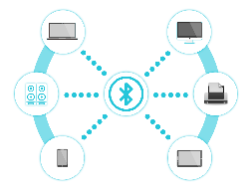



Intellectual properties
Patent: the exclusive right to use or sell an invention. There are several kinds:
patents on a device
patents on an artistic design
patents on a mechanical design
patents on a plant (created by a botanist)
Be An Entrepreneur 2022-2023

Slide 23
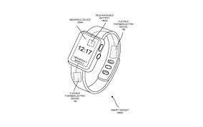
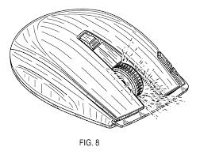
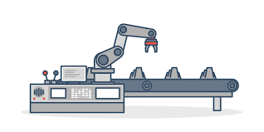
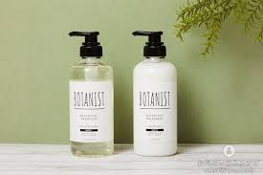
Intellectual properties
Be An Entrepreneur 2022-2023

Slide 24


Intellectual properties
Trademark:
a word or symbol used by a manufacturer or merchant to identify their goods and distinguish them from others.
A trademark is designated by the symbol ®
Be An Entrepreneur 2022-2023

Slide 25

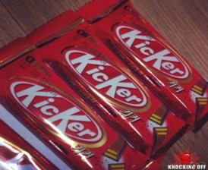
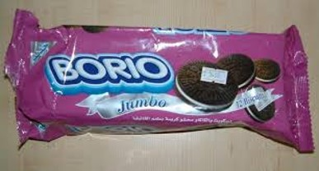
Piracy
Be An Entrepreneur 2022-2023

Slide 26



Intellectual properties
Trade secret:
A secret formula, method, device, or item of information that gives an entrepreneur an advantage over competitors.
Be An Entrepreneur 2022-2023

Slide 27
Review Questions
How can I analyze the business opportunity from the point of view of customers?
An existing product for an existing market?
Cite some sources of business ideas.
7
5
What are some types of human needs?
3
6
Will the product sell (will be business get funding) if it is about:
1
4
If I am confronted with a hundred different opportunities, how can I trim down the list to ten?
2
What guide questions can help me search for business ideas?
Be An Entrepreneur 2022-2023

Slide 28
Review Questions
What guide questions should the entrepreneur ask to decide what business he wants to set up?
Why is it useful to think about the resources available to you?
14
What are some guide questions to ask once you have picked a specific product or a service?
12
Who among you want a business that matches your personality? Will you adapt to the business, or will the business adapt to you?
10
13
A variation of an existing product?
8
11
What is a unique selling proposition?
9
Be An Entrepreneur 2022-2023
A totally New product?

Slide 29
Review Questions
What is a trademark?
19
What is a patent?
We can classify the business opportunity into class A, B, or C.
17
18
What is a copyright?
15
16
What does the book say about the different classes of business opportunities?
Be An Entrepreneur 2022-2023

Slide 30
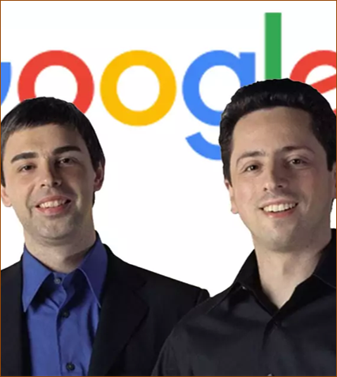
Case Study questions
Who were Larry Page and Sergey Brin?
How did they develop their business opportunity?
What observation from the academic world, inspired their business idea?
2
Be An Entrepreneur 2022-2023

Slide 31
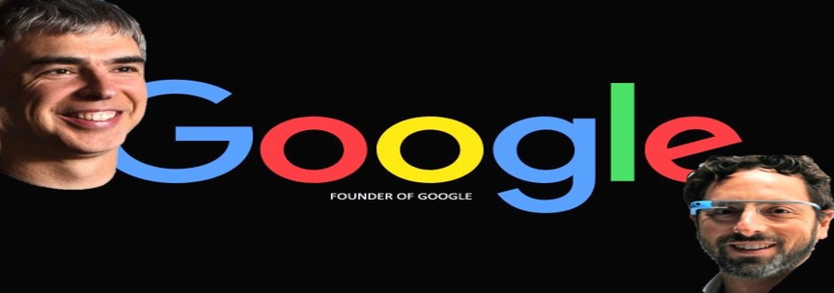
Case Study questions
What trends did they ride on to develop their business idea?
What was Google’s unique selling proposition?
What needs does Google meet?
2
Be An Entrepreneur 2022-2023

