Slide 1

BE AN Entrepreneur
Be An Entrepreneur 2022-2023

Slide 2



Chapter 10
HIRING PEOPLE
Be An Entrepreneur 2022-2023

Slide 3

HIRING PEOPLE
Managers and Staff
Note on Human Capital
1
2
3
4
HR Processes
Organizational Chart
Be An Entrepreneur 2022-2023

Slide 4
Coverage of the Chapter
Managers and Staff
Hire Specialists
Job description
How to Supervise
Appoint senior managers
Table of organization
Note on human capital
Note on hiring close friends
Be An Entrepreneur 2022-2023

Slide 5

Learning Objectives
Learn
Learn how to hire managers and staff
Learn
Learn how to hire specialists
Understand
Understand the need for a job description
Know
Know how to supervise employees
Understand
Understand the role of the COO and the CEO
Build
Build a table of organization
Understand
Understand the value of human capital
Be An Entrepreneur 2022-2023
Be
Be able to decide if close friends can work in the business

Slide 6
Story from Real Life
Entrepreneur: Dawn Barnes, founder of Dawn Barnes Karate Kids Inc. in Santa Monica, California. It is a karate school that focuses on inspiring self-esteem in every child.
Startup Costs: $15,000 in 1995.
Projected 2005 sales: $2.5 million.
Entrepreneur’s problem: there was no one she could hire to teach in this special way.
She had to train herself in martial arts before she could start to teach using her special way.
In 1984, Dawn Barnes enrolled herself and her two young sons in a karate class.
Be An Entrepreneur 2022-2023

Slide 7
Story from Real Life
By signing up, this former ballerina and stuntwoman started down the path to becoming a third-degree black belt and successful entrepreneur.
Fascinated by the physical/spiritual balance of martial arts, Barnes trained diligently.
Ten years later, she opened a school.
Focusing on respect, patience, kindness, and honesty, all 1,200 students, ages 4 to 14, finish each class with the thought:
“Make your mind strong, your body strong, your spirit strong."
Be An Entrepreneur 2022-2023

Slide 8
HR Processes
The following are the various HR processes:
1
Human resource planning
3
Performance Management.
2
Employee remuneration and Benefits Administration.
4
Employee Relations.
Be An Entrepreneur 2022-2023

Slide 9
Human Resource Planning:
It aims at attracting applicants that match a certain Job criterion.
The next level of filtration. Aims at short listing candidates who are the nearest match in terms qualifications, expertise, and potential for a certain job.
Recruitment
Selection
Hiring
Training and Development
  Deciding upon the final candidate who gets the job.
Those processes that work on an employee onboard for his skills and abilities upgradation.
Be An Entrepreneur 2022-2023

Slide 10



Managers and Staff
The first people whom you have to convince about your business idea are your prospective managers and employees. They have to be persuaded that you have a workable venture.
You may need 3 types of people :
1
2
3
Managers: to supervise workers as team leaders, department heads.
Technical Specialists: doctors in a private clinic, lawyers in a law firm, artists for a design firm.
Staff secretaries, research assistants, workers to package and deliver, etc
Be An Entrepreneur 2022-2023

Slide 11
Managers and Staff
Job Description
Before you hire people, make a list of all the duties that you will require from each employee. This list should be used to create a job description. The job description is like a contract between you and the employee that outlines your expectations and the tasks that you require the employee to perform.
Be An Entrepreneur 2022-2023

Slide 12
Managers and Staff
How to Supervise
Whether you supervise your employees directly or through team leaders, speak daily with the workers one on one. Each worker should hear from his boss:
Be An Entrepreneur 2022-2023

Slide 13

Managers and Staff
Any other work-related item that you want to discuss?
Here is what I need from you today (this week)
What problems are you encountering in your work?
These are your goals and objectives
What do you need from me so that you can do your job well?
Here is your list of things to do
This is the standard of “a job well done?
Any questions?
If you do well, there will be incentives. If not, penalties
With relentless follow-up you can get things done through other people
Be An Entrepreneur 2022-2023

Slide 14



Organizational Chart
A table of organization sets out the areas of responsibility and the lines of reporting.
Be An Entrepreneur 2022-2023

Slide 15
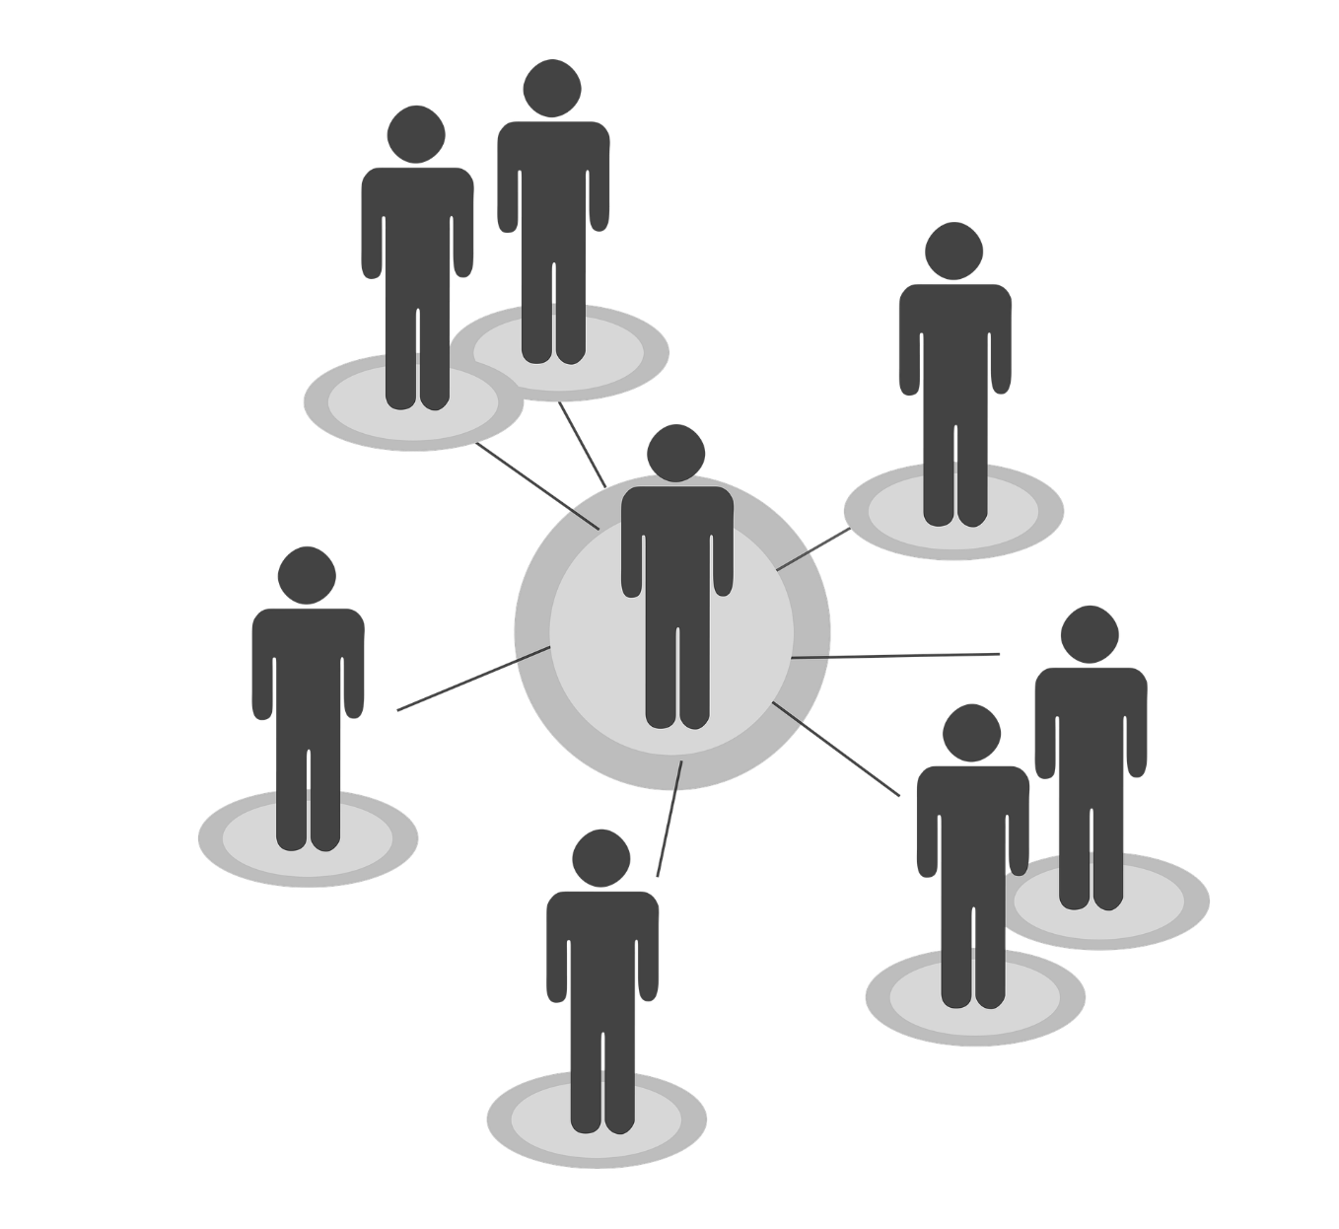
Organizational Chart
Organizational Chart is a graphic representation of the structure of an organization showing the relationships of the positions or jobs within it.
It shows the internal structure of an organization or company. The employees and positions are represented by boxes or other shapes, sometimes including photos, contact information, email and page links, icons and illustrations.
Organizational Chart illustrates employee designations, reporting managers and more. Visually, they are a bunch of boxes and lines: boxes represent people, lines represent reporting relationships and operating levels.
Be An Entrepreneur 2022-2023

Slide 16
Organizational Chart
There are three main types of org charts: hierarchical, matrix and flat.
1
Hierarchical Org Chart: This is the most common type, and it gives rise to the synonym Hierarchy Chart. A hierarchy is where one group or person is at the top, while those with less power are beneath them, in the shape of a pyramid.
2
Matrix Org Chart: This is usually only seen when individuals have more than one manager. For example, an organization could have a team of graphic designers who all report to the head graphic designer. The graphic designers are also working on other projects that are likely headed by a separate project manager.
Be An Entrepreneur 2022-2023

Slide 17
Organizational Chart
Flat Org Chart: This type, sometimes referred to as a Horizontal Org Chart, has little or no levels of middle management and typically consists of two levels: the top administrators and the workers. In companies like this, the workers have more responsibility and are more directly involved in decision-making.
3
Limitations of org charts
They can quickly become out of date, especially in organizations with a large amount of turnover.
They show only formal relationships, and not the informal or social relationships that help to get things done in an organization.
They don’t reflect management style.
Be An Entrepreneur 2022-2023

Slide 18
Note on Human Capital
The sum of total skills and talents of a company, can be referred to as its human capital.
1
2
Human capital makes the firm productive.
It is the “brain,” that organizes the material resources of the firm, to make the firm profitable.
3
Be An Entrepreneur 2022-2023

Slide 19
Note on Human Capital
The business owner, the boss, must manage his team closely.
4
With close supervision, each worker will know what to do, what is expected of him, and how to do a good job.
5
If all workers are productive, the business will prosper.
6
Be An Entrepreneur 2022-2023

Slide 20
Note on Human Capital
In case the number of workers is large, then the boss must find some way to delegate supervision to department heads or team leaders.
7
8
At some point, the Chairman and Chief Executive Officer of the company must appoint a Chief Operating Officer, who would direct the various departments.
Be An Entrepreneur 2022-2023

Slide 21
Note on Human Capital
The COO could supervise the managers of the marketing department, the finance, and accounting department, and the production department.
9
He would handle day-to-day management.
10
The chairman and CEO should learn to delegate because he should concentrate on “future” issues.
11
Be An Entrepreneur 2022-2023

Slide 22
Note on Human Capital
Should you hire a friend or family in your start-up company?
12
In Asia, Latin America, and Africa, businessmen believe it is better to hire friends and family because they are more reliable.
13
In Europe and North America, they are in favor of not hiring friends or family so that the boss can fire anyone who is not performing well.
14
Be An Entrepreneur 2022-2023

Slide 23
Glossary
a rich individual who invests in early-stage companies in exchange for equity ownership in the business.
funds used to start operating your company.
Human Capital
Promotions
Market Research
Marketing Communications
declaration that the company is unable to pay back its loans.
property or other belongings that the bank can confiscate if you fail to pay your loan.
Be An Entrepreneur 2022-2023

Slide 24
Glossary
Packaging
the department that prepares how to wrap the product, for example, in a box or with plastic.
3
Procurement
Delivery
buying things the company needs
4
how to deliver the product to your customers or outlets that carry your product
1
2
Processing
changing raw materials to finished products.
Be An Entrepreneur 2022-2023

Slide 25
Glossary
Management Consulting
giving advice on how to run a company
7
Distribution
Economic forecasting
the department that takes care of making your product available to the public
8
giving predictions on how the economy will perform
5
6
Treasury
the department that takes care of the revenues or funds of your company
Be An Entrepreneur 2022-2023

Slide 26
Review Questions
Why are good people hard to find, for a young company?
Why do you even have to “sell” your business idea to your prospective managers and employees?
What kinds of workers would the entrepreneur need to hire?
How many supervisors should you hire?
How many senior managers should there be?
What is the work of the chief operating officer?
Be An Entrepreneur 2022-2023

Slide 27
Review Questions
How should the boss discuss assignments with each worker, everyday?
Give examples of industries where the main assets are the intelligence and skills of the employees.
Be An Entrepreneur 2022-2023

Slide 28
Case Study questions
TiVo
Why does the case say about knowing the right people, choosing good partners?
Did they have a good management team?
Did they approach the right funders?
2
Be An Entrepreneur 2022-2023

