Slide 1

BE AN Entrepreneur
Be An Entrepreneur 2022-2023

Slide 2














Be an Entrepreneur
The Entrepreneur
Part 1:
Chapters : 1,2,3,4
The Business Plan Chapters : 5,6,7,8
Part 2:
The Enterprise
Chapters : 9,10,1,11,12,13
Part 3:

Slide 3




Chapter 1
Entrepreneurship: Concepts & History
Be An Entrepreneur 2022-2023

Slide 4

Concepts & History
History of Entrepreneurship
The Business World Needs Entrepreneurs
1
2
3
4
5
Definition of Entrepreneurship
Examples of Entrepreneurship
Trends: Entrepreneurial Economy
Be An Entrepreneur 2022-2023

Slide 5
Chapter 1 overview
………..
1
2
3
4
5
In this chapter, you will be introduced to entrepreneurship, the art of founding a business.
This chapter contains formal definitions of entrepreneurship. It sets the subject in its historical context.
As you read through this chapter, note the growing importance of entrepreneurship in today’s global work environment.
Notice the various motivations of people in starting their own business.
Self-assessment questions will help to determine if entrepreneurship is something you want to do in life.
Be An Entrepreneur 2022-2023

Slide 6

Learning Objectives
Define
Define entrepreneurship
Understand
Understand how entrepreneurship has evolved through the years
Cite some success stories of entrepreneurs
Define social entrepreneurship and explain why it is relevant in today’s world
Define
Understand
Understand Trends under Entrepreneurial Economy
Be An Entrepreneur 2022-2023

Slide 7

Story from Real Life
During his studies at MIT University in 2011, Saudi young man Abdulaziz Al-Ghunaim got acquainted with Atef Javed to participate with him not only in student housing at the university, but also in creating a platform that became an example of social entrepreneurship. Tarjimly, then, is a non-profit technology platform that connects displaced people and those affected by natural disasters with interpreters around the world. The aim of it is to solve the refugee problem because they are in a country whose mother tongue is not spoken, so all their dealings become in a language other than their language, so that they have a huge obstacle.
Be An Entrepreneur 2022-2023

Slide 8
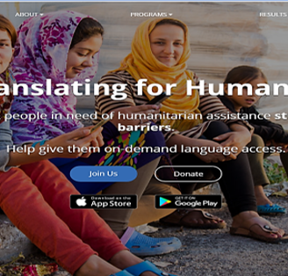
Story from Real Life
Today Tarjimly has 1,200 refugee service users, 900 aid workers, 60 organizations using the service, and in return 3000 translators in different languages ​​and the platform offers 16 different language options.
How could this project relate to Social Entrepreneurship?
Be An Entrepreneur 2022-2023

Slide 9
1. Definition of Entrepreneurship
“Creating a value-added venture that is creative and able to take the risk”.
Webster’s dictionary: an entrepreneur is “one who organizes and directs a business undertaking, assuming the risk for the sake of profit.”
Entrepreneurship: the art and skill of founding a business.
The word “entrepreneur” comes from the French word entreprendre, which means “to undertake.”
Be An Entrepreneur 2022-2023

Slide 10
2. History of Entrepreneurship
Schumpeter’s studies (1883-1950).
The Equilibrium Theory
“economies of scale.” era
Economic shocks and recessions 70s – 80s
Promoting Growth and Sustainability instead of mass production
Small enterprises contribution: Australia, Finland, and the Asian Tigers
Be An Entrepreneur 2022-2023

Slide 11
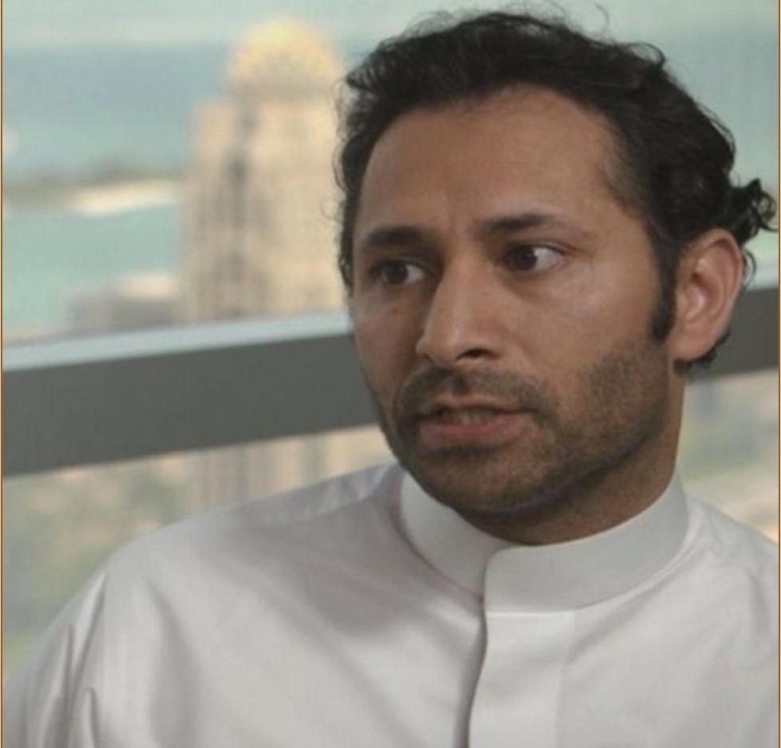
3. Examples of Entrepreneurship
Abdulla Elyas. He is one of the founders of Careem, a transportation network company worth $2 billion as of 2020. He has over 10 years of professional experience in managing and consulting of software.
Careem now is a subsidiary of American company Uber. It is based in Dubai, with operations running in over 100 cities, covering 15 countries including the Middle East, Africa, and South Asia regions.
Be An Entrepreneur 2022-2023

Slide 12

3. Examples of Entrepreneurship
Abdulaziz Aljouf is a well-known Saudi entrepreneur and the founder and CEO of PayTabs, a payment processing company with a total of US$20 million in investment.
In 2021, he was awarded the Prize of Esameyoon as the role model of Saudi Entrepreneurs.
PayTabs is Originally backed by Saudi Aramco’s “Waed” and later by private Saudi investment, over the years, PayTabs has in-built and exported a full stack of game changing solutions.
Be An Entrepreneur 2022-2023

Slide 13



4. The Business World Needs Entrepreneurs
1
2
3
When entrepreneurs succeed, the results benefit the whole society.
The world re-focuses from BIG to SMALL
a state’s achievement is translated into economic growth, only with the intervention of entrepreneurs.
Be An Entrepreneur 2022-2023

Slide 14

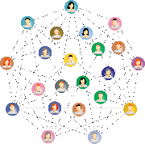


5. Trends: Entrepreneurial Economy
Technology Entrepreneurship
Social Entrepreneurship
Transformational Entrepreneurship
Intrapreneurship
Be An Entrepreneur 2022-2023

Slide 15
Technology Entrepreneurship
“Establishment of a new technology venture”
High Attributes characterize technological entrepreneurship are :
Potential Opportunity
Technology-Intensive Opportunity
Unique Technology Capable of Driving a New Business
High Risk of Failure
Longer Time to Market
Be An Entrepreneur 2022-2023
Demand of Infrastructure, Facilities and Resources

Slide 16
Technology Entrepreneurship
Social entrepreneurship is a way of solving social problems by using entrepreneurial genius.
1
This movement has become very attractive, especially to those who are idealistic and want to change the world
2
Grameen Bank in Bangladesh
3
Local Examples: Glowork, King Khalid Foundation, Misk
4
Be An Entrepreneur 2022-2023

Slide 17
Transformational Entrepreneurship
Transformational Entrepreneurship happens at the convergence of Technology Entrepreneurship and Social Entrepreneurship
1
2
Improving investment climate :
Simplify Admin Procedures.
Monitoring investment environment.
Be An Entrepreneur 2022-2023

Slide 18
Transformational Entrepreneurship
Cooperation and partnership between local & Foreign investors.
Activation of economic cities to give them a competitive edge to attract foreign & local partnerships.
Simplify government procedures in IT licenses.
Encouraging the establishment of modern technology zones.
Developing industrial cities, plots & Tech zones
Eliminate the duplication in GOV Procedures.
Be An Entrepreneur 2022-2023

Slide 19
Transformational Entrepreneurship
Enhance innovation culture
Focusing on innovation-supporting mechanisms:
2
Funding for R&D
Encourage the adoption of new Technologies
Be An Entrepreneur 2022-2023

Slide 20


Intrapreneurship
The Naming
(intra) means (within). So, “intrapreneurship” is meant to be entrepreneurship inside established institutions.
Origin of the word
"the birth of new arrangements inside existing situations, and a resurrection of established corporations by the new ideas & approaches”
Preparing ground for practicing entrepreneurship on the corporate level.
Establishing new projects within companies.
Adoption of initiatives proposed by workers.
Be An Entrepreneur 2022-2023
“strategic innovation”.

Slide 21
Points to Remember
A new trend in the world of business is the rise of the social entrepreneur, who combines profit-making with solving social ills.
1
Entrepreneurship is the art of founding a business
3
Entrepreneurs help economies grow because they create wealth and employment.
2
Entrepreneurs make money or increase wealth, using creativity and innovation
4
Be An Entrepreneur 2022-2023

Slide 22
Ask Yourself
1
Which biographies of great businessmen have influenced me the most?
4
Who are the entrepreneurs that I personally know?
2
Which biographies of great businessmen have influenced me the most?
5
Who among them has impressed me the most?
3
Which biographies of great businessmen have influenced me the most?
6
Why have they impressed me?
Be An Entrepreneur 2022-2023

Slide 23
Ask Yourself
1
Do small companies always move faster, in tune with shifting consumer tastes?
4
What social problems are there in my community?
2
Are big companies always better than small companies at marketing?
5
In ten minutes, can I list down who is trying to solve these problems?
3
Why have they impressed me?
6
If I were given $1 million, what could I do with it, to change the world?
Be An Entrepreneur 2022-2023

Slide 24
Ask Yourself
What are the different definitions of entrepreneurship?
1
2
Who first coined the term “entrepreneur”?
4
What does the Schumpeterian theory say about entrepreneurship?
3
Who had the most impact on how the world now defines entrepreneurship?
5
Who had the most impact on how the world now defines entrepreneurship?
Be An Entrepreneur 2022-2023

Slide 25
Review Questions
What are the pros and cons of entrepreneurship?
Give examples of social entrepreneurs and what they do.
Cite examples of successful entrepreneurs.
7
5
Why was the 20th century called “The Century of The Entrepreneur”?
3
6
What is social entrepreneurship?
1
4
What impact does entrepreneurship have on a country’s economy as a whole?
2
What are the latest trends on entrepreneurship?
Be An Entrepreneur 2022-2023

Slide 26





Case Study: Facebook
He became Forbes’ youngest self-made billionaire in 2008 for having started the social-networking tool called Facebook.
In 2020, Forbes ranked Zuckerberg at No. 8 on its ‘Billionaires’ list.
Mark Zuckerberg looks like any other computer whiz. At 25 years of age, he was called the “The Toddler CEO” by an American journalist.
By June 2021 it had 2.8 billion monthly active users and its revenue reached around $86 billion.
The magazine estimated his net worth to be about $280 billion in 2021.
2
Be An Entrepreneur 2022-2023

Slide 27

Case Study: Facebook
How would you compare the features of social networking websites?
Is there an opportunity for any new feature to be introduced that is not yet being offered?
What makes Mark Zuckerberg an entrepreneur?
2
Be An Entrepreneur 2022-2023

