Slide 1

BE AN Entrepreneur
Be An Entrepreneur 2022-2023

Slide 2
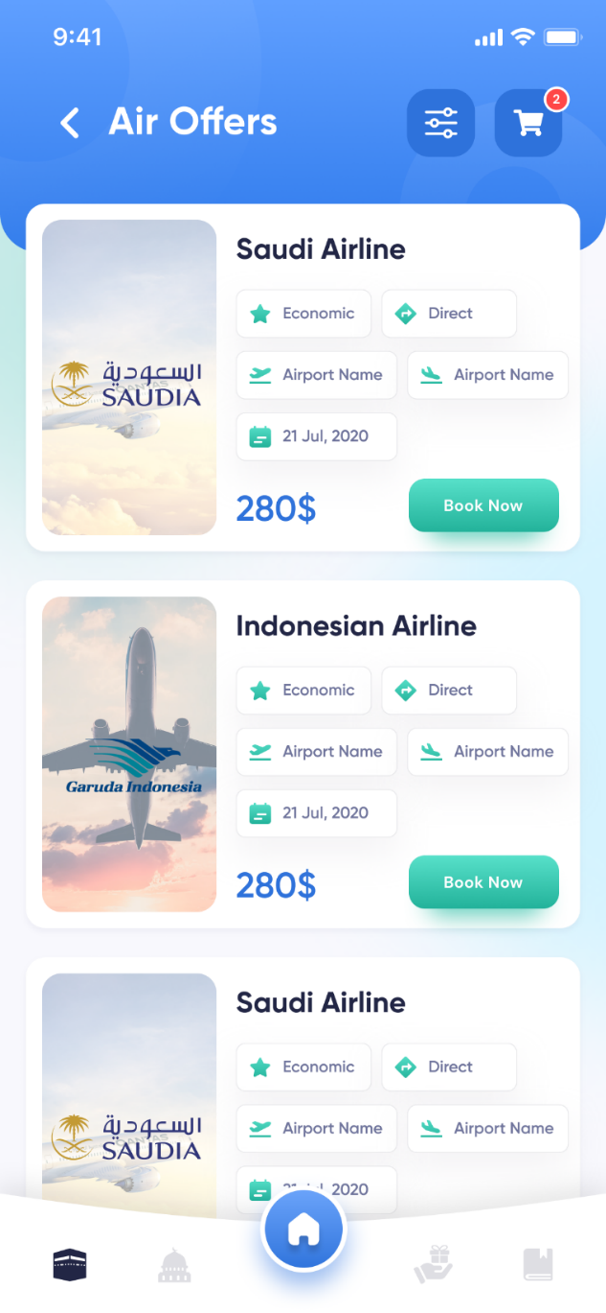



Chapter 3
Ownership Structure Of The Business
Be An Entrepreneur 2022-2023

Slide 3

Ownership Structure Of The Business
Types of ownership
Size of the business
1
2
3
Types of businesses
Be An Entrepreneur 2022-2023

Slide 4

Learning Objectives
Discuss
Discuss the different types of ownership structures and the pros and cons of each
Understand
Understand why business and legal structures are important
Define
Define the different types of businesses and their pros and cons
Discuss how to evaluate an existing business
Discuss
Learn
Learn the advantages and disadvantages of going into franchising
Discuss the different business sizes and why small businesses are booming
Be An Entrepreneur 2022-2023
Discuss

Slide 5
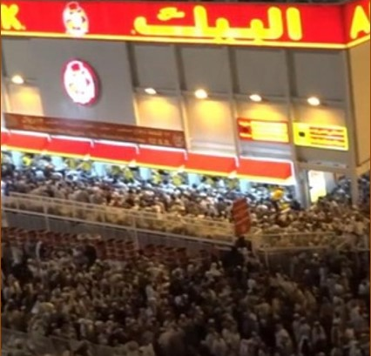
Story from Real Life
Al Baik is a restaurant serving fried chicken or what is commonly called “Broast”. The word al-Bay Al Baik is a word taken from the Ottoman term (Pasha). The history of Al Baik restaurants began with the founding of the father of the owners of Al Baik. He started a restaurant serving fried chicken on behalf of a foreign company called “Broast”, and he was its agent in Jeddah in 1974, but the people's acceptance of this type of meal at that time was not encouraging. The name also spread so much, that the brand melted and came to mean the same meal. Two years later, the founder died, leaving behind a debt-laden business that his sons Ihsan and Rami had to confront.
Be An Entrepreneur 2022-2023

Slide 6
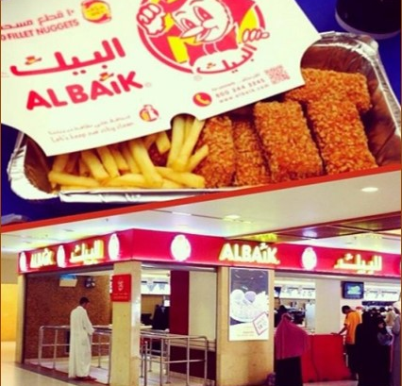
Story from Real Life
The decisive decision was to change the name from “Broast” to Al Baik, in order to distinguish the product from the rest of the competing restaurants, so Al Baik trained the employees on the art of service, arranging work and quality in the product, so that the customer could feel the difference between Al Baik and other restaurants. Al Baik was also keen on appropriate pricing for a high value meal. In 2017, CNN ranked the Saudi Al Baik Restaurant as the eight best restaurants in the world, and ranked sixth, as one of the eight best non-American fast-food restaurants. Today, Al Baik is spread in several Saudi cities, with more than 70 branches until 2020, and it is on its way to spread abroad.
What type of business Ihsan and Rami have chosen?
Be An Entrepreneur 2022-2023

Slide 7
Types of Ownership
Types of Ownership
1
2
3
4
5
Sole proprietorship
General partnership
Corporation
Limited Liability
Nonprofit
corporation
Be An Entrepreneur 2022-2023

Slide 8
Sole proprietorship
Sole Proprietorship
legal presence
Sole proprietorship. This is the simplest form of structure to set up. It is the oldest and most common form of business in the world.
A business that falls under this category has no legal existence separate from its owner. So, if your business goes in claim the business’s assets and your own assets as payment. to debt, those you borrow from can
Be An Entrepreneur 2022-2023

Slide 9
Sole proprietorship
Pros of Sole Proprietorship Structure
You control the business.
Easy and cheaper to set up.
You own all profits.
Few administrative duties.
You can decide matters quickly.
Profits are taxed as personal income.
Be An Entrepreneur 2022-2023

Slide 10
Sole proprietorship
Cons of Sole Proprietorship Structure
Hard to obtain financing.
If the business can›t pay its debts, those you borrowed from can go after what you own!
Big burden on your shoulders.
Salary is often low and the benefits minimal.
You manage all the different aspects of the business
Be An Entrepreneur 2022-2023

Slide 11
General partnership
are personally liable for all transactions of the business and run the same risk of unlimited liability as proprietors in the event of business failure.
Be An Entrepreneur 2022-2023

Slide 12
General partnership
Pros of General Partnership Structure
Raises capital for the business
Partners can pool their knowledge
Few administrative duties
Relatively easy to set up
Partners share the liability
Be An Entrepreneur 2022-2023

Slide 13
General partnership
Cons of General Partnership Structure
You are not protected from the bad financial decisions of your partner
Limited tax savings— only direct, out of pocket expenses can be deducted
1
2
3
Can be difficult to dissolve
4
Disagreements among partners can be unpleasant
Be An Entrepreneur 2022-2023

Slide 14
Corporation
Corporation: A legal entity that exists apart From the people who created it. The corporation is owned by its shareholders and run by board of directors elected by the shareholders. Shares of a corporation: Equal parts of the ownership of a company.
Be An Entrepreneur 2022-2023

Slide 15
Limited Liability Company
Limited Liability Company: A legal form of business that provides limited liability to its owners. It is not a corporation. But like a corporation, it provides limited liability. An LLC is often more flexible than a corporation. It is a form of organization well suited to companies with u single owner
Be An Entrepreneur 2022-2023

Slide 16
Nonprofit corporations
Nonprofits are mission-driven. These organizations must determine how to measure the change that they want and then determine how much it costs to achieve that change.
Nonprofit corporations are corporations organized to provide a service to the community, not to create wealth for individual shareholders.
Examples of Nonprofit are Misk, Bab Rizq Jameel, and Entrepreneurship Association.
A nonprofit cannot be bought and sold like a business. Stock cannot be issued to raise money or transfer the corporation.
Be An Entrepreneur 2022-2023

Slide 17
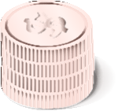


Types of Businesses
1
2
3
Start-up
Franchise
Buy an existing business
Be An Entrepreneur 2022-2023

Slide 18


Start-ups
60%
70%
Most startups do not evolve into large and long-term firms
More than 60 percent are out of business in the first six years
More than 70 percent are out of business in the first eight years
Evidence suggests that of those that survive, most remain small
Be An Entrepreneur 2022-2023

Slide 19
Start-ups
Disadvantage
Unique idea or opportunity
Unlimited potential growth and earnings
Many variables for which you will initially have assumptions rather than facts
Advantage
2
N0 assurance that you can acquire enough customers within a certain timeframe
Be An Entrepreneur 2022-2023

Slide 20
Buy an existing business
Advantages of Buying a Business
1
Financial track record can be reviewed to analyze performance.
2
The current owner trains you to take over.
4
The business may offer a prime location.
3
Customers are already familiar with the product. Supplier and vendor relationships are already established.
5
Employees are established.
Be An Entrepreneur 2022-2023

Slide 21
Buy an existing business
Advantages of Buying a Business
6
Loan approvals are easier to obtain for an established business.
8
Record keeping and accounting systems are already installed.
7
The existing owner may be willing to finance part of the new business.
Be An Entrepreneur 2022-2023

Slide 22
Buy an existing business
Disadvantages of buying business.
1
The cost is generally more than that 0f a start-up.
2
The owners’ real reason for selling may be kept from you.
4
Customer satisfaction levels may be below what you are led to believe.
3
The validity of financial statements may be questioned.
5
Condition of assets may be worse than it appears.
Be An Entrepreneur 2022-2023

Slide 23
Buy an existing business
Disadvantages of buying business.
6
Existing employees may not be suitable.
9
Change and innovation may be difficult to bring about.
7
Equipment and facilities may be obsolete or in need of repair.
10
Receivables may be worth less than face value.
8
The inventory may be outdated.
11
The business may be overpriced
Be An Entrepreneur 2022-2023

Slide 24
A franchise agreement is an agreement under which one party (the franchiser) grants to another (the franchisee) the rights to market or distribute a patented or trademarked product or service in exchange for payment or royalties.
FRANCHISE
Be An Entrepreneur 2022-2023

Slide 25
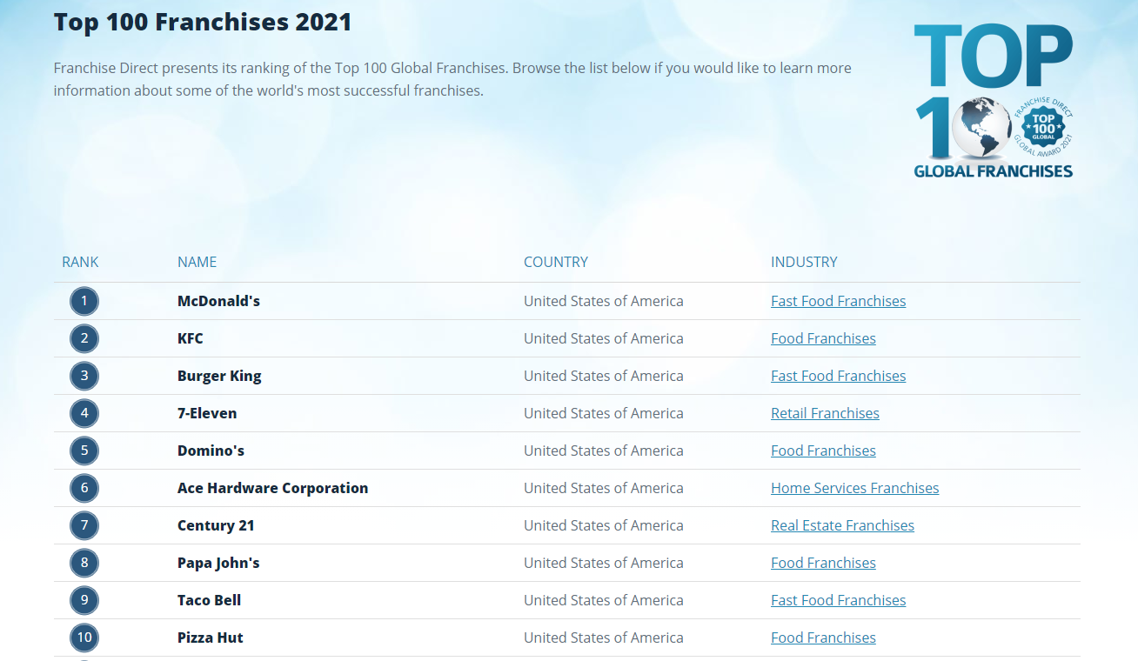
FRANCHISE
Be An Entrepreneur 2022-2023

Slide 26
FRANCHISE
Statistics
3 k$
50%
There are more than three thousand franchise opportunities in the U.S. alone.
Franchises cover every type of business imaginable. Franchises control 50 percent of retail sales in the U.S. A new franchise opens somewhere in the world every six minutes.
Be An Entrepreneur 2022-2023

Slide 27
Franchise
Advantages of Franchising
1
Provides a proven formula for success.
4
Brand and trade names are already established.
2
Provides training programs for new owners.
5
Accounting systems are pre-tested and established.
3
Advertising and promotional programs are initiated by the franchise.
6
Franchises offer volume discounts on purchases.
Be An Entrepreneur 2022-2023

Slide 28
Franchise
Disadvantages of Franchising
1
High start-up costs.
4
Some franchises require a renewal fee after a period of time.
2
You have to pay franchise fees and annual fees.
5
Growth of franchise may be limited by contract.
3
Franchisees must abide by the operating restrictions of the franchise.
Be An Entrepreneur 2022-2023

Slide 29
Franchise
Some of the Thing You Should Ask if You Are Evaluating a Franchise
Is the franchise responsive to the franchisees requirements? How good was the training?
Are the franchisees meeting their targets?
How pleased are the franchisees with their decision?
Would they consider opening a second franchise?
How good is business?
2
Be An Entrepreneur 2022-2023

Slide 30
Size of the Business
1
2
3
4
Micro-business
Small
Medium
Large
Be An Entrepreneur 2022-2023

Slide 31
Size of the Business
Micro-Business: Less than SR 3M
Small: 3-40 SR M
Saudi Arabia
Medium: 40-200 SR M
Be An Entrepreneur 2022-2023

Slide 32
Size of the Business
A micro business is a small business that operates on a very small scale. That scale is typically measured according to the business’s number of employees, total worth, and occasionally how much money was required to start the business. In Saudi Arabia firm is classified as a microbusiness if it has less than 5 employees, and annual sales less than SR 3 million. Examples of micro business such as a mobile accessory store, yoga training center, handmade products and food trucks.
Micro business
Be An Entrepreneur 2022-2023

Slide 33
Size of the Business
Small businesses refer to businesses with small operating sizes. There are several criteria for categorizing companies based on their business size, including the number of employees, income, invested capital, market capitalization, and output volume. However, the categories and the basis for categorizing can vary between countries. In some definitions, they may have fewer than 100 employees. They are usually privately owned by a single individual or a small group of individuals
Small business
Be An Entrepreneur 2022-2023

Slide 34
Points to Remember
When starting a business, you have to decide on which ownership structure to use single proprietorship, general partnership, limited partnership, and corporation.
1
There are other options for special needs, like limited partnership and non-profit corporation.
2
Be An Entrepreneur 2022-2023

Slide 35
Points to Remember
Each ownership structure has advantages and disadvantages. Sole proprietorship is easiest to set up but do not protect owners from liabilities. General partnerships are used primarily by professionals in associations like lawyers and doctors. They are also easy to set up, but each partner inherits the financial mistakes of the other.
3
Be An Entrepreneur 2022-2023

Slide 36
Points to Remember
4
If you want to raise more capital but not give up control over your business, you can get a limited partner.
If you decide to set up a corporation, you should get ready for significant administrative requirements and high costs of setting up the company. But the benefits are you get protected from liability as an owner, you can easily raise capital by going to the stock market or selling bonds, and the corporation can last for a long time.
5
Be An Entrepreneur 2022-2023

Slide 37
Points to Remember
You can use your knowledge of business and legal structures to grow your company, take over another company, or position your company to enjoy certain business trends.
6
Be An Entrepreneur 2022-2023

Slide 38
Points to Remember
To evaluate whether an existing business is doing well, you need to look at its financial records to see if it is profitable and if it can generate cash. You also need to observe its competitive advantage in its market, assess whether its customer base is growing and figure out whether its employees are productive.
7
Be An Entrepreneur 2022-2023

Slide 39
Points to Remember
To buy a business, you need to follow the following steps: figure out whether the business for sale matches your personal and financial goals, visit the business and asses its financial reports, history, price and the reason why its for sale, request a second meeting if these information meet your standards, and then review the facility closely to determine how it has been managed and maintained.
8
Be An Entrepreneur 2022-2023

Slide 40
Points to Remember
The advantages of franchising are: proven formula for success, training programs for new owners, no need to spend for advertising and promotional programs, brand has already been built, provides tried and tested accounting systems, franchises offer volume discounts on purchases, and gives you a built-in market and proven product.
9
Be An Entrepreneur 2022-2023

Slide 41
Points to Remember
The disadvantages of franchising are: high startup costs, upfront franchise fees, annual fees and renewal fees, restrictions in operating the business, and some contracts may limit growth of your franchise.
10
Be An Entrepreneur 2022-2023

Slide 42
Points to Remember
Businesses typically start small and grow into medium-scale businesses to big corporations. Advances in technology in the telecommunications and information technology sectors now allow home-based businesses to compete with big companies both locally and internally.
11
Be An Entrepreneur 2022-2023

Slide 43
Points to Remember
Growing a company from small to big will require you, the business owner, to delegate and manage the business.
12
Be An Entrepreneur 2022-2023

Slide 44
Review Questions
What sort of business structure is for people who can work alone?
When choosing a business form, you should consult certain professionals. Who should you consult?
3
What sort of business structure is for people who need the skills of a friend or a brother, and funding from others?
4
1
2
If the business entity expects to hold real estate, should you make it a corporation or LLC as the business structure?
Be An Entrepreneur 2022-2023

Slide 45
Review Questions
What structure allows you to raise your business capital without giving up control over your business?
3
Which is the simplest form of structure to set up?
4
What is a legal entity that exists apart from the people who created it? How is it formed?
1
2
What sort of structure is often used by groups of lawyers or doctors?
Be An Entrepreneur 2022-2023

Slide 46
Review Questions
Does an entrepreneur always need the protection of the law?
What are the four characteristics of this legal entity that is owned by shareholders?
3
4
What are some principles of successful bootstrap startups?
1
2
What is a corporation that is organized to provide a service to the community?
Be An Entrepreneur 2022-2023

Slide 47
Review Questions
How can you make it easier to evaluate an existing business? Who should you call?
What are some of the tough questions that the entrepreneur should ask, after launching the company?
3
4
What is the success rate in franchising, compared to independently owned business?
1
2
What is the advantage of buying an existing business versus starting up a new company?
Be An Entrepreneur 2022-2023

Slide 48
Review Questions
Is it true that building a business is like building a kingdom, or an empire?
What does it take to build a company from small to big?
5
3
What is the deal between the franchiser and the franchisee?
4
Is it important for the founder of a company, to learn how to delegate?
1
2
What are the advantages of franchising?
Be An Entrepreneur 2022-2023

Slide 49

Case Study questions
Pretend that you are a business consultant for Sobhi A. Batterjee when he was still trying to figure out how to structure his business. What kind of business structure would you propose? Why?
Faced with extreme poverty and extreme risk, would you dare to start a business or just beg for help. Why.
How intensely did the brothers have to work to realize their dream?
2
Be An Entrepreneur 2022-2023

